Slide 1

Big Data (CS-3032)
Kalinga Institute of Industrial Technology
Deemed to be University
Bhubaneswar-751024
School of Computer Engineering
Strictly for internal circulation (within KIIT) and reference only. Not for outside circulation without permission
3 Credit
Lecture Note

Slide 2
Course Contents
Sr # | Major and Detailed Coverage Area | Hrs
3 | Big Data Tools | 8
 | NOSQL, MapReduce – Hadoop, HDFS, Hive, MapR – Hadoop -YARN - Pig and PigLatin, Jaql - Zookeeper - HBase, Cassandra- Oozie, Lucene- Avro, Mahout. Hadoop Distributed file systems.

Slide 3

NoSQL

Slide 4
Database
Database
RDBMS
NoSQL
OLAP
OLTP

Slide 5
OLTP vs. OLAP
OLTP | OLAP
Many short transactions | Long transactions, complex queries
Example: Update account balance Add book to shopping cart Enroll in course | Example: Count the classes with fewer than 10 classes Report total sales for each dept in each month
Queries touch small amounts of data (few records) | Queries touch large amounts of data
Updates are frequent | Updates are infrequent
Concurrency is biggest performance problem | Individual queries can require lots of resources

Slide 6
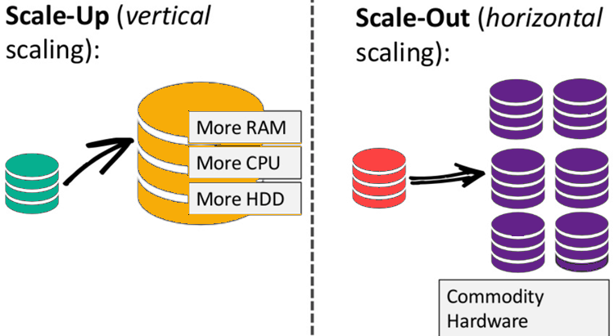
NoSQL
NoSQL database stands for "Not Only SQL" or "Not SQL."
It is a non-relational database, that does not require a fixed schema, and avoids joins.
It is used for distributed data stores and specifically targeted for Big Data, for example Google or Facebook which collects terabytes of data every day for their users.
Traditional RDBMS uses SQL syntax to store and retrieve data for further insights. Instead, a NoSQL database system encompasses a wide range of database technologies that can store structured, semi-structured, and unstructured data.
It adhere to Brewer’s CAP theorem.
The tables are stored as ASCII files and each field is separated by tabs
The data scale horizontally.

Slide 7
Why and Uses of NoSQL
Why: In today’s time data is becoming easier to access and capture through third parties such as Facebook, Google+ and others. Personal user information, social graphs, geo location data, user-generated content and machine logging data are just a few examples where the data has been increasing exponentially. To avail the above service properly, it is required to process huge amount of data which SQL databases were never designed. The evolution of NoSql databases is to handle these huge data properly.
Uses:
Log analysis
Where to use NoSQL?
Social networking feeds
Time-based data

Slide 8
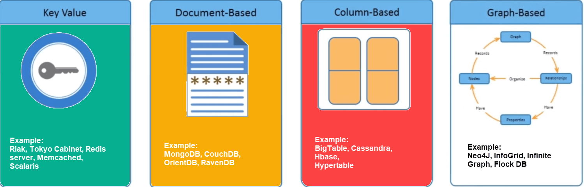
Types of NoSQL Database
There are mainly four categories of NoSQL databases. Each of these categories has its unique attributes and limitations.
Performance
Scalability
Flexibility
Functionality
High | High | High | Variable
High | High | Moderate | Minimal
High | Variable (high) | High | Variable (low)
Variable | Variable | Variable | Graph Theory

Slide 9
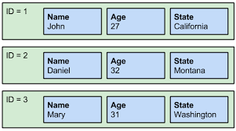
Key Value
Data is stored in key/value pairs. It is designed in such a way to handle lots of data and heavy load. Key-value pair storage databases store data as a hash table where each key is unique, and the value can be a JSON, BLOB, string, etc. It is one of the most basic types of NoSQL databases. This kind of NoSQL database is used as a collection, dictionaries, associative arrays, etc. Key value stores help the developer to store schema-less data. They work best for shopping cart contents. Redis, Dynamo, Riak are some examples of key-value store.
SQL
ID | Name | Age | State
1 | John | 27 | California
NoSQL – Key Value
Key (i.e. ID) | Values
1 | Name: John Age:27 State: California

Slide 10
Document-Based
Document-Oriented NoSQL DB stores and retrieves data as a key value pair but the value part is stored as a document. The document is stored in JSON or XML formats. The document type is mostly used for CMS (Content Management Systems), blogging platforms, real-time analytics & e-commerce applications. It should not use for complex transactions which require multiple operations or queries against varying aggregate structures.
SQL
NoSQL – Document-Based
ID | Name | Age | State
1 | John | 27 | California
Key (ID) | Value (JSON)
1 | { “Name”: John “Age”:27 “State”: California }

Slide 11
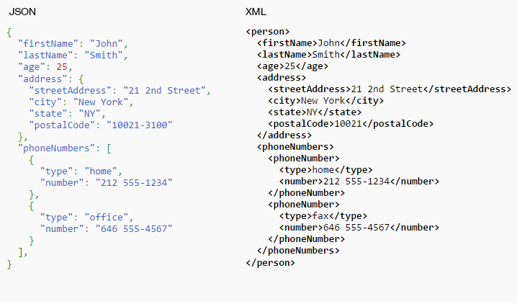
JSON vs. XML format

Slide 12
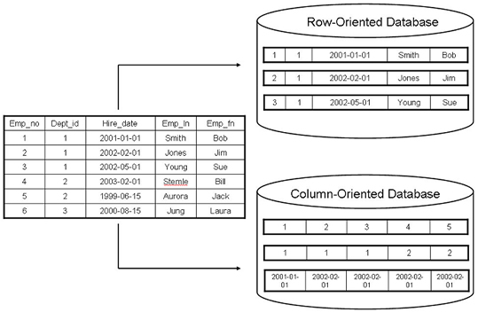
Column-Oriented vs. Row-Oriented Database

Slide 13
Column-Oriented vs. Row-Oriented Database cont’d
Row Oriented | Column Oriented
Data is stored and retrieved one row at a time and hence could read unnecessary data if some of the data in a row are required. | In this type of data stores, data are stored and retrieve in columns and hence it can only able to read only the relevant data if required.
Records in Row Oriented Data stores are easy to read and write. | In this type of data stores, read and write operations are slower as compared to row-oriented.
Row-oriented data stores are best suited for online transaction system. | Column-oriented stores are best suited for online analytical processing.
These are not efficient in performing operations applicable to the entire datasets and hence aggregation in row-oriented is an expensive job or operations. | These are efficient in performing operations applicable to the entire dataset and hence enables aggregation over many rows and columns.

Slide 14
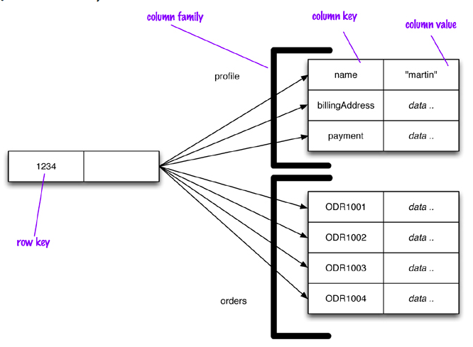
Column-Based Database
Column-oriented databases work on column family and based on BigTable paper by Google. Every column is treated separately. Values of single column databases are stored contiguously. They deliver high performance on aggregation queries like SUM, COUNT, AVG, MIN etc. as the data is readily available in a column. Such NoSQL databases are widely used to manage data warehouses, business intelligence, CRM, Library card catalogs etc.

Slide 15
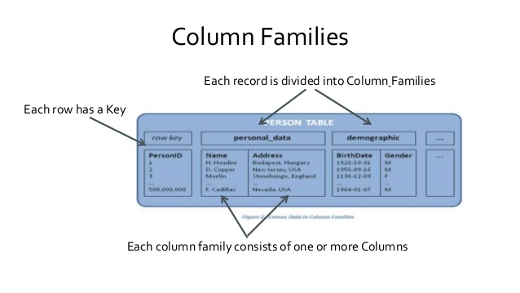
Column-Based cont’d

Slide 16
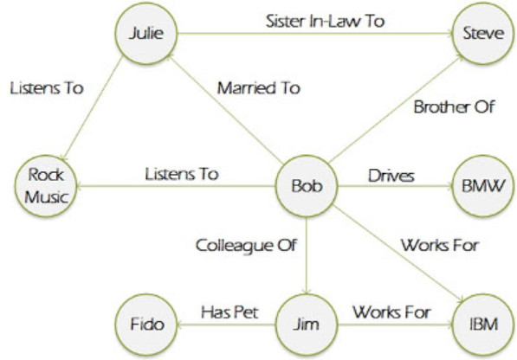
Graph-Based
A graph type database stores entities as well the relations amongst those entities. The entity is stored as a node with the relationship as edges. An edge gives a relationship between nodes. Every node and edge has a unique identifier. Graph base database mostly used for social networks, logistics, spatial data.

Slide 17
Advantages of NoSQL
Can be used as Primary or Analytic Data Source
Big Data Capability
No Single Point of Failure
Easy Replication
No Need for Separate Caching Layer
Provides fast performance and horizontal scalability.
Can handle structured, semi-structured, and unstructured data with equal effect
NoSQL databases don't need a dedicated high-performance server
Support Key Developer Languages and Platforms
Simple to implement than using RDBMS
It can serve as the primary data source for online applications.
Handles big data which manages data velocity, variety, volume, and complexity
Excels at distributed database and multi-data center operations
Eliminates the need for a specific caching layer to store data
Offers a flexible schema design which can easily be altered without downtime or service disruption

Slide 18
Disadvantages of NoSQL
No standardization rules
Limited query capabilities
RDBMS databases and tools are comparatively mature
It does not offer any traditional database capabilities, like consistency when multiple transactions are performed simultaneously.
When the volume of data increases it is difficult to maintain unique values as keys become difficult
Doesn't work as well with relational data
The learning curve is stiff for new developers
Open source options so not so popular for enterprises.

Slide 19
SQL vs. NoSQL
SQL | NoSQL
Relational database | Non-relational, distributed database
Relational model | Model-less approach
Pre-defined schema | Dynamic schema for unstructured data
Table based databases | Document-based or graph-based or wide column store or key-value pairs databases
Vertically scalable (by increasing system resources) | Horizontally scalable (by creating a cluster of commodity machines)
Uses SQL | Uses UnQL (Unstructured Query Language)
Not preferred for large datasets | Largely preferred for large datasets
Not a best fit for hierarchical data | Best fit for hierarchical storage as it follows the key-value pair of storing data similar to JSON
Emphasis on ACID properties | Follows Brewer’s CAP theorem

Slide 20
SQL vs. NoSQL cont’d
SQL | NoSQL
Excellent support from vendors | Relies heavily on community support
Supports complex querying and data keeping needs | Does not have good support for complex querying
Can be configured for strong consistency | Few support strong consistency (e.g., MongoDB), few others can be configured for eventual consistency (e.g., Cassandra)
Examples: Oracle, DB2, MySQL, MS SQL, PostgreSQL, etc. | Examples: MongoDB, HBase, Cassandra, Redis, Neo4j, CouchDB, Couchbase, Riak, etc.

Slide 21

Hadoop

Slide 22
Hadoop
Hadoop is an open-source project of the Apache Foundation. Apache Hadoop is written in Java and a collection of open-source software utilities that facilitate using a network of many computers to solve problems involving massive amounts of data and computation. It provides a software framework for distributed storage and processing of big data and uses Google’s MapReduce and Google File System as its foundation.
Hadoop
Apache open-source software framework
Inspired by:
Google MapReduce
Google File System
Hadoop provides various tools and technologies, collectively termed as Hadoop ecosystem, to enable development and deployment of Big Data solutions. It accomplishes two tasks namely i) Massive data storage, and ii) Faster data processing.

Slide 23
Flood of data
Let’s look at few stastics to get an idea of data gets generated every day, every minute, and every second.
Every day
NYSE generates 1.5 billion shares and trade data
Facebook stores 2.7 billion comments and likes
Google processes about 24 petabytes of data
Every minutes
Facebook users share nearly 2.5 million pieces of content.
Amazon generates over $ 80,000 in online sale
Twitter users tweet nearly 300,000 times.
Instagram users post nearly 220,000 new photos
Apple users download nearly 50,000 apps.
Email users send over 2000 million messages
YouTube users upload 72 hrs of new video content
Every second
Banking applications process more than 10,000 credit card transactions.

Slide 24


Data Challenges
To process, analyze and made sense of these different kinds of data, a system is needed that scales and address the challenges as shown:
“I am flooded with data”. How to store terabytes of mounting data?
“I have data in various sources. I have data that rich in variety – structured, semi-structured and unstructured”. How to work with data that is so very different?
“I need this data to be proceed quickly. My decision is pending”. How to access the information quickly?

Slide 25
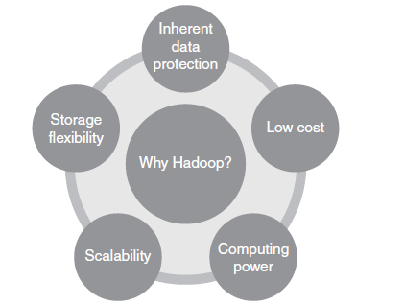
Why Hadoop
Its capability to handle massive amounts of data, different categories of data – fairly quickly.
Considerations

Slide 26
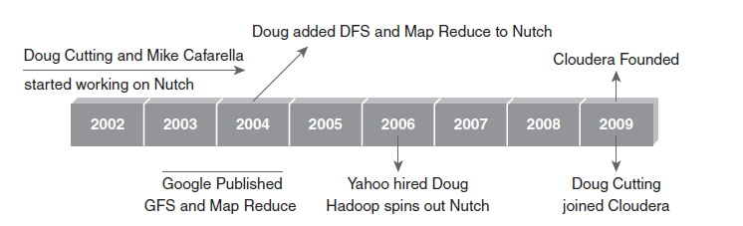
Hadoop History
Hadoop was created by Doug Cutting, the creator of Apache Lucene (text search library). Hadoop was part of Apace Nutch (open-source web search engine of Yahoo project) and also part of Lucene project. The name Hadoop is not an acronym; it’s a made-up name.

Slide 27
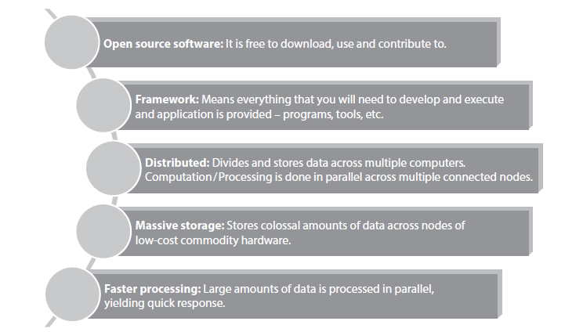
Key Aspects of Hadoop

Slide 28
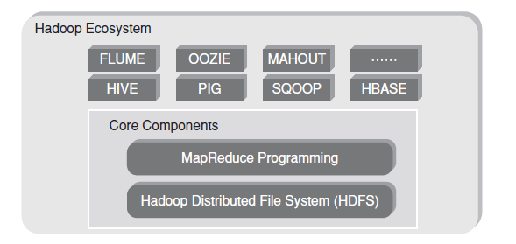
Hadoop Components

Slide 29
Hadoop Components cont’d
Hadoop Core Components:
HDFS
Storage component
Distributed data across several nodes
Natively redundant
MapReduce
Computational Framework
Splits a task across multiple nodes
Process data in parallel
Hadoop Ecosystems: These are support projects to enhance the functionality of Hadoop Core components. The projects are as follows:
Hive
Pig
Sqoop
Flume
Oozie
Mahout
HBase

Slide 30
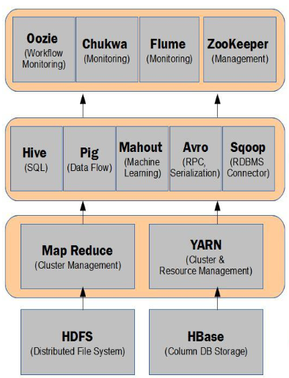
Hadoop Ecosystem Elements at various Stages of Data Processing
Data Management
Data Access
Data Processing
Data Storage

Slide 31
Version of Hadoop
There are 3 versions of Hadoop available:
Hadoop 1.x
Hadoop 2.x
Hadoop 3.x
Hadoop 1.x vs. Hadoop 2.x
Hadoop 1.x
Hadoop 2.x
MapReduce
Data Processing & Resource Management
MapReduce
Other Data Processing Framework
YARN
Resource Management
HDFS
Distributed File Storage
(redundant, reliable storage)
HDFS2
Distributed File Storage
(redundant, highly-available, reliable storage)

Slide 32
Hadoop 2.x vs. Hadoop 3.x
Characteristics | Hadoop 2.x | Hadoop 3.x
Minimum supported version of java | Java 7 | Java 8
Fault tolerance | Handled by replication (which is wastage of space). | Handled by erasure coding
Data Balancing | Uses HDFS balancer | Uses Intra-data node balancer, which is invoked via the HDFS disk balancer CLI.
Storage Scheme | Uses 3X replication scheme. E.g. If there is 6 block so there will be 18 blocks occupied the space because of the replication scheme. | Support for erasure encoding in HDFS. E.g. If there is 6 block so there will be 9 blocks occupied the space 6 block and 3 for parity.
Scalability | Scale up to 10,000 nodes per cluster. | Scale more than 10,000 nodes per cluster.

Slide 33
High Level Hadoop 2.0 Architecture
Hadoop is distributed Master-Slave architecture.
Distributed data storage
Client
Distributed data processing
HDFS
YARN
HDFS Master Node
YARN Master Node
Active Namenode
Resource Manager
Master
Standby Namenode
Secondary Namenode
HDFS Slave Node
YARN Slave Node
DataNode 1
Slave
Node Manager 1
DataNode n
Node Manager n

Slide 34
High Level Hadoop 2.0 Architecture cont’d
Resource Manager
Node Manager
Node Manager
Node Manager
YARN
HDFS
Cluster
NameNode
DataNode
DataNode
DataNode

Slide 35
Hadoop Distributors
The top 8 vendors offering Big Data Hadoop solution are:
Integrated Hadoop Solution
Cloudera
HortonWorks
Amazon Web Services Elastic MapReduce Hadoop Distribution
Microsoft
MapR
IBM InfoSphere Insights
Cloud-Based Hadoop Solution
Amazon Web Service
Google BigQuery

Slide 36

Hadoop HDFS

Slide 37
Hadoop HDFS
The Hadoop Distributed File System (HDFS) is the primary data storage system used by Hadoop applications.
HDFS holds very large amount of data and employs a NameNode and DataNode architecture to implement a distributed file system that provides high-performance access to data across highly scalable Hadoop clusters.
To store such huge data, the files are stored across multiple machines.
These files are stored in redundant fashion to rescue the system from possible data losses in case of failure.
It’s run on commodity hardware.
Unlike other distributed systems, HDFS is highly fault-tolerant and designed using low-cost hardware.

Slide 38
Hadoop HDFS Key points
Some key points of HDFS are as follows:
Storage component of Hadoop.
Distributed File System.
Modeled after Google File System.
Optimized for high throughput (HDFS leverages large block size and moves computation where data is stored).
One can replicate a file for a configured number of times, which is tolerant in terms of both software and hardware.
Re-replicates data blocks automatically on nodes that have failed.
Sits on top of native file system

Slide 39
HDFS Daemons
Key components of HDFS are as follows:
NameNode
DataNodes
Blocks: Generally the user data is stored in the files of HDFS. HDFS breaks a large file into smaller pieces called blocks. In other words, the minimum amount of data that HDFS can read or write is called a block. By default the block size is 128 MB in Hadoop 2.x and 64 MB in Hadoop 1.x. But it can be increased as per the need to change in HDFS configuration.
Secondary NameNode
Standby NameNode
Hadoop 2.X
Hadoop 1.X
200 MB – abc.txt
200 MB – abc.txt
128 MB – Block 1
?
72 MB – Block 2
Why block size is large?
Reduce the cost of seek time and 2. Proper usage of storage space

Slide 40
Rack
A rack is a collection of 30 or 40 nodes that are physically stored close together and are all connected to the same network switch. Network bandwidth between any two nodes in rack is greater than bandwidth between two nodes on different racks. A Hadoop Cluster is a collection of racks.
Switch
Node 1
S
W
I
T
C
H
Node 1
S
W
I
T
C
H
Node 1
S
W
I
T
C
H
Node 2
Node 2
Node 2
Node N
Node N
Node N
Rack 1
Rack 2
Rack N

Slide 41
NameNode
NameNode is the centerpiece of HDFS.
NameNode is also known as the Master.
NameNode only stores the metadata of HDFS – the directory tree of all files in the file system, and tracks the files across the cluster.
NameNode does not store the actual data or the dataset. The data itself is actually stored in the DataNodes
NameNode knows the list of the blocks and its location for any given file in HDFS. With this information NameNode knows how to construct the file from blocks.
NameNode is usually configured with a lot of memory (RAM).
NameNode is so critical to HDFS and when the NameNode is down, HDFS/Hadoop cluster is inaccessible and considered down.
NameNode is a single point of failure in Hadoop cluster.
Configuration
Processors: 2 Quad Core CPUs running @ 2 GHz
RAM: 128 GB
Disk: 6 x 1TB SATA
Network: 10 Gigabit Ethernet

Slide 42
NameNode Metadata
Metadata stored about the file consists of file name, file path, number of blocks, block Ids, replication level.
This metadata information is stored on the local disk. Namenode uses two files for storing this metadata information.
FsImage
NameNode in HDFS also keeps in it’s memory, location of the DataNodes that store the blocks for any given file. Using that information Namenode can reconstruct the whole file by getting the location of all the blocks of a given file.
EditLog
Example
(File Name, numReplicas, rack-ids, machine-ids, block-ids, …)
/user/in4072/data/part-0, 3, r:3, M3, {1, 3}, …
/user/in4072/data/part-1, 3, r:2, M1, {2, 4, 5}, …
/user/in4072/data/part-2, 3, r:1, M2, {6, 9, 8}, …

Slide 43
DataNode
DataNode is responsible for storing the actual data in HDFS.
DataNode is also known as the Slave
NameNode and DataNode are in constant communication.
When a DataNode starts up it announce itself to the NameNode along with the list of blocks it is responsible for.
When a DataNode is down, it does not affect the availability of data or the cluster. NameNode will arrange for replication for the blocks managed by the DataNode that is not available.
DataNode is usually configured with a lot of hard disk space. Because the actual data is stored in the DataNode.
Configuration
Processors: 2 Quad Core CPUs running @ 2 GHz
RAM: 64 GB
Disk: 12-24 x 1TB SATA
Network: 10 Gigabit Ethernet

Slide 44
Secondary NameNode
Secondary NameNode in Hadoop is more of a helper to NameNode, it is not a backup NameNode server which can quickly take over in case of NameNode failure.
EditLog– All the file write operations done by client applications are first recorded in the EditLog.
FsImage– This file has the complete information about the file system metadata when the NameNode starts. All the operations after that are recorded in EditLog.
When the NameNode is restarted it first takes metadata information from the FsImage and then apply all the transactions recorded in EditLog. NameNode restart doesn’t happen that frequently so EditLog grows quite large. That means merging of EditLog to FsImage at the time of startup takes a lot of time keeping the whole file system offline during that process.
Secondary NameNode take over this job of merging FsImage and EditLog and keep the FsImage current to save a lot of time. Its main function is to check point the file system metadata stored on NameNode.

Slide 45
Secondary NameNode cont’d
The process followed by Secondary NameNode to periodically merge the fsimage and the edits log files is as follows:
Secondary NameNode pulls the latest FsImage and EditLog files from the primary NameNode.
Secondary NameNode applies each transaction from EditLog file to FsImage to create a new merged FsImage file.
Merged FsImage file is transferred back to primary NameNode.
1
2
NameNode
Secondary NameNode
3
It’s been an hour, provide your metadata

Slide 46
Standby NameNode
With Hadoop 2.0, built into the platform, HDFS now has automated failover with a hot standby, with full stack resiliency.
Automated Failover: Hadoop pro-actively detects NameNode host and process failures and will automatically switch to the standby NameNode to maintain availability for the HDFS service. There is no need for human intervention in the process – System Administrators can sleep in peace!
Hot Standby: Both Active and Standby NameNodes have up to date HDFS metadata, ensuring seamless failover even for large clusters – which means no downtime for your HDP cluster!
Full Stack Resiliency: The entire Hadoop stack (MapReduce, Hive, Pig, HBase, Oozie etc.) has been certified to handle a NameNode failure scenario without losing data or the job progress. This is vital to ensure long running jobs that are critical to complete on schedule will not be adversely affected during a NameNode failure scenario.

Slide 47
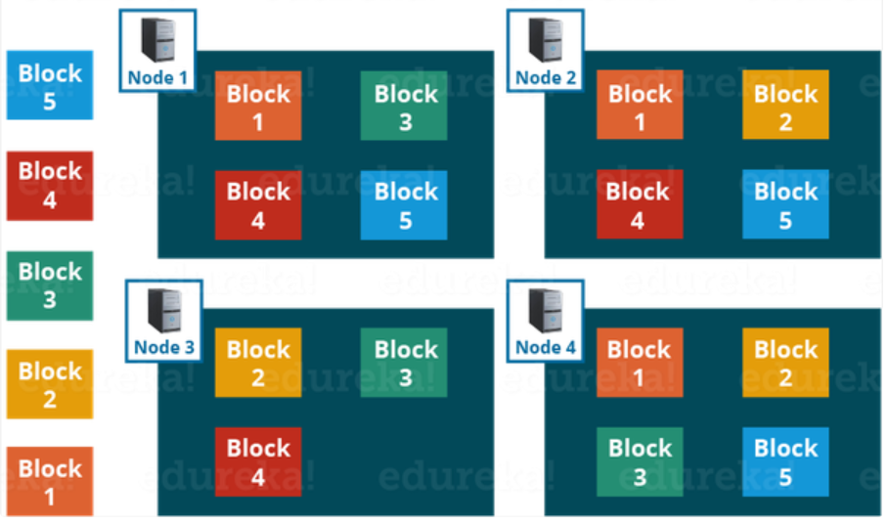
Replication
HDFS provides a reliable way to store huge data in a distributed environment as data blocks. The blocks are also replicated to provide fault tolerance. The default replication factor is 3 which is configurable. Therefore, if a file to be stored of 128 MB in HDFS using the default configuration, it would occupy a space of 384 MB (3*128 MB) as the blocks will be replicated three times and each replica will be residing on a different DataNode.

Slide 48
Rack Awareness
All machines in rack are connected using the same network switch and if that network goes down then all machines in that rack will be out of service. Thus the rack is down. Rack Awareness was introduced by Apache Hadoop to overcome this issue. In Rack Awareness, NameNode chooses the DataNode which is closer to the same rack or nearby rack. NameNode maintains Rack ids of each DataNode to achieve rack information. Thus, this concept chooses DataNodes based on the rack information. NameNode in Hadoop makes ensures that all the replicas should not stored on the same rack or single rack. Default replication factor is 3. Therefore according to Rack Awareness Algorithm:
When a Hadoop framework creates new block, it places first replica on the local node, and place a second one in a different rack, and the third one is on different node on same remote node.
When re-replicating a block, if the number of existing replicas is one, place the second on a different rack.
When number of existing replicas are two, if the two replicas are in the same rack, place the third one on a different rack.

Slide 49
Rack Awareness & Replication
File
B1
Block 1
B3
Block 3
B1
B2
B3
B2
Block 2
DN 1
DN 1
DN 1
B3
B1
B2
DN 2
DN 2
DN 2
B1
B2
B3
DN 3
DN 3
DN 3
B3
B1
B2
DN 4
DN 4
DN 4
Rack 1
Rack 2
Rack 3

Slide 50
Rack Awareness Advantages
Provide higher bandwidth and low latency – This policy maximizes network bandwidth by transferring block within a rack rather than between racks. The YARN is able to optimize MapReduce job performance by assigning tasks to nodes that are closer to their data in terms of network topology.
Provides data protection against rack failure – Namenode assign the block replicas of 2nd And 3rd Block to nodes in different rack from the first replica. Thus, it provides data protection even against rack failure. However, this is possible only if Hadoop was configured with knowledge of its rack configuration.
Minimize the writing cost and Maximize read speed – Rack awareness, policy places read/write requests to replicas which are in the same rack. Thus, this minimizes writing cost and maximizes reading speed.

Slide 51
Anatomy of File Write
HDFS follow Write once Read many models. So files can’t be edited that are already stored in HDFS, but data can be appended by reopening the file.
1. Create
Distributed
File System
2. Create
NameNode
HDFS
Client
3. Write
FSData
OutputStream
6. Close
Client JVM
7. Complete
Client Node
4. Write Packet
5. Acknowledge Packet
DataNode1
4
DataNode2
4
DataNode3
5
5
Pipelines of DataNode

Slide 52
Anatomy of File Write cont’d
The client calls create function on DistributedFileSystem (a class extends from FileSystem) to create a file.
The RPC call to the NameNode happens through the DistributedFileSystem to create a new file. The NameNode performs various checks (existence of the file) to create a new file. Initially, the NameNode creates a file without associating any data blocks to the file. The DistributedFileSystem returns an FSDataOutputStream (i.e. class instance) to the client to perform write.
As the client writes data, data is split into packets by DFSOutputStream (i.e. a class), which is then written to the internal queue, called data queue. DataStreamer (i.e. a class) consumes the data queue. The DataStreamer requests the NameNode to allocate new blocks by selecting a list of suitable DataNodes to store replicas. The list of DataNodes makes a pipeline. With the default replication factor of 3, there will be 3 nodes in the pipeline for the first block.

Slide 53
Anatomy of File Write cont’d
DataStreamer streams the packets to first DataNode in the pipeline. It stores packet and forwards it to the second DataNode in the pipeline. In the sameway, the cecond DataNode stores the packet and forwards to the third DataNode in the pipeline.
In additional to the internal queue, DFSOutputStream also manages an “Ack queue” of packets that are waiting for the acknowledgement by DataNodes. A packet is removed from the “Ack Queue” only if it is acknowledged by all the DataNodes in the pipeline.
When the client finishes writing the file, it calls close() on the stream.
This flushes all the remaining packets to the DataNode pipeline and waits for relevant acknowledgements before communicating with the NameNode to inform the client that the creation of file is complete.

Slide 54
Anatomy of File Read
1. Open
Distributed
File System
2. Get Block Location
NameNode
HDFS
Client
3. Read
FSData
InputStream
5. Close
Client JVM
Client Node
4.1. read
4.2. read
4.3. read
DataNode1
DataNode2
DataNode3
DataNodes

Slide 55
Anatomy of File Write cont’d
The client opens the file that it wishes to read from by calling open() on the DistributedFileSystem
DistributedFileSystem communicates with the NameNode to get the location of the data blocks. NameNode returns the address of the DataNodes that the data blocks are stored on. Subsequent to this, DistributedFileSystem returns DFSInputStream (i.e. a class) to the client to read from the file.
Client then calls read() on the stream DFSInputStream, which has address of the DataNodes for the first few blocks of the file, connects to the closet DataNode for the first block in the file.
Client calls read() repeatedly to stream the data from the DataNode.
When the end of the block is reached, DFSInputStream closes the connection with the DataNode. It repeats the steps to find the best DataNode for the next block and subsequent blocks.
When the client completes the reading of the file, it calls close() on FSDataInputStream to close the connection.

Slide 56
HDFS Commands
To get the list of directories and files at the root of HDFS.
hadoop fs –ls /
To create a directory (say, sample) in HDFS
hadoop fs –mkdir /sample
To copy a file from local file system to HDFS
hadoop fs –put /root/sample/test.txt /sample/test.txt
To copy a file from HDFS to local file system
hadoop fs –get /sample/test.txt /root/sample/test.txt
To display the contents of an HDFS file on console
hadoop fs –cat /sample/test.txt
To copy a file from one directory to another on HDFS
hadoop fs –cp /sample/test.txt /sample1
To remove a directory from HDFS
hadoop fs –rm –r /sample1

Slide 57
HDFS Example
Let’s assume that this sample.txt file contains few lines as text. The content of the file is as follows:
Hello I am expert in Big Data
How can I help you
How can I assist you
Are you an engineer
Are you looking for coding
Are you looking for interview questions
what are you doing these days
what are your strengths
Hence, the above 8 lines are the content of the file. Let’s assume that while storing this file in Hadoop, HDFS broke this file into four parts and named each part as first.txt, second.txt, third.txt, and fourth.txt. So, you can easily see that the above file will be divided into four equal parts and each part will contain 2 lines. First two lines will be in the file first.txt, next two lines in second.txt, next two in third.txt and the last two lines will be stored in fourth.txt. All these files will be stored in DataNodes and the Name Node will contain the metadata about them. All this is the task of HDFS.

Slide 58

Data Processing with Hadoop

Slide 59
Data Processing with Hadoop
MapReduce is a processing technique and a program model for distributed computing based on java. It is built on divide and conquer algorithm.
In MapReduce Programming, the input dataset in split into independent chunks.
It contains two important tasks, namely Map and Reduce.
Map takes a set of data and converts it into another set of data, where individual elements are broken down into tuples (key/value pairs). The processing primitive is called mapper. The processing is done in parallel manner. The output produced by the map tasks serves as intermediate data and is stored on the local disk of that server.
Reduce task takes the output from a map as an input and combines those data tuples into a smaller set of tuples. The processing primitive is called reducer. The input and output are stored in a file system.
Reduce task is always performed after the map job.
The major advantage of MapReduce is that it is easy to scale data processing over multiple computing nodes and takes care of other tasks such as scheduling, monitoring, re-executing failed tasks etc.

Slide 60
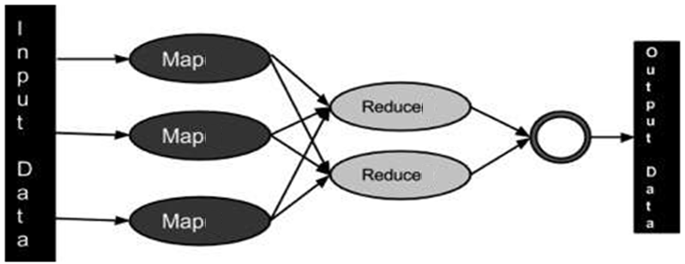
Data Processing with Hadoop cont’d

Slide 61
Data Processing with Hadoop cont’d
The main advantages is that we write an application in the MapReduce form, scaling the application to run over hundreds, thousands, or even tens of thousands of machines in a cluster with a configuration change.
MapReduce program executes in three stages: map stage, shuffle & sorting stage, and reduce stage.
Map Stage: The map or mapper’s job is to process the input data. Generally the input data is in the form of file or directory and is stored in the Hadoop file system (HDFS). The input file is passed to the mapper function line by line. The mapper processes the data and creates several small chunks of data.
Shuffle & Sorting Stage: Shuffle phase in Hadoop transfers the map output from Mapper to a Reducer in MapReduce. Sort phase in MapReduce covers the merging and sorting of map outputs.
Reducer Stage: The Reducer’s job is to process the data that comes from the mapper. After processing, it produces a new set of output, which will be stored in the HDFS.

Slide 62
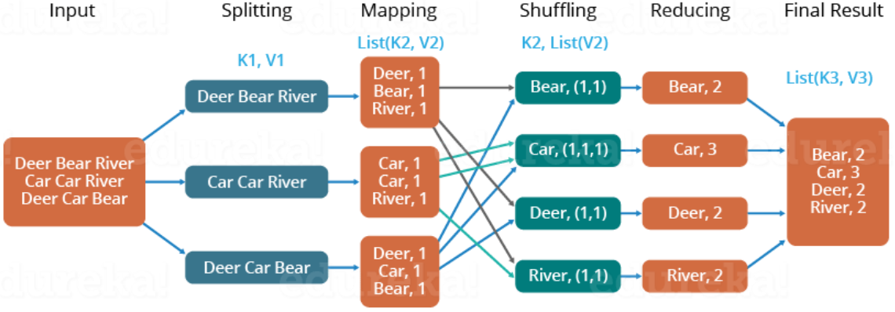
How MapReduce Work?
At the crux of MapReduce are two functions: Map and Reduce. They are sequenced one after the other.
The Map function takes input from the disk as <key,value> pairs, processes them, and produces another set of intermediate <key,value> pairs as output.
The Reduce function also takes inputs as <key,value> pairs, and produces <key,value> pairs as output.

Slide 63
Working of MapReduce
The types of keys and values differ based on the use case. All inputs and outputs are stored in the HDFS. While the map is a mandatory step to filter and sort the initial data, the reduce function is optional.
<k1, v1> -> Map() -> list(<k2, v2>)
<k2, list(v2)> -> Reduce() -> list(<k3, v3>)
Mappers and Reducers are the Hadoop servers that run the Map and Reduce functions respectively. It doesn’t matter if these are the same or different servers.
Map: The input data is first split into smaller blocks. Each block is then assigned to a mapper for processing. For example, if a file has 100 records to be processed, 100 mappers can run together to process one record each. Or maybe 50 mappers can run together to process two records each. The Hadoop framework decides how many mappers to use, based on the size of the data to be processed and the memory block available on each mapper server.

Slide 64
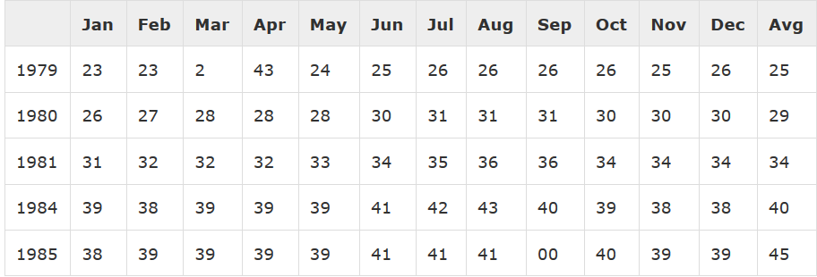
Working of MapReduce cont’d
Reduce: After all the mappers complete processing, the framework shuffles and sorts the results before passing them on to the reducers. A reducer cannot start while a mapper is still in progress. All the map output values that have the same key are assigned to a single reducer, which then aggregates the values for that key.
Class Exercise 1
Class Exercise 2
Draw the MapReduce process to count the number of words for the input:
Dog Cat Rat
Car Car Rat
Dog car Rat
Rat Rat Rat
Draw the MapReduce process to find the maximum electrical consumption for each year:
Year

Slide 65
Data Locality
When a dataset is stored in HDFS, it is divided in to blocks and stored across the DataNodes in the Hadoop cluster. When a MapReduce job is executed against the dataset the individual Mappers will process the blocks (input splits). When the data is not available for the Mapper in the same node where it is being executed, the data needs to be copied over the network from the DataNode which has the data to the DataNode which is executing the Mapper task. Imagine a MapReduce job with over 100 Mappers and each Mapper is trying to copy the data from another DataNode in the cluster at the same time, this would result in serious network congestion as all the Mappers would try to copy the data at the same time and it is not ideal. So it is always effective and cheap to move the computation closer to the data than to move the data closer to the computation. When the data is located on the same node as the Mapper working on the data, it is referred to as Data Local. In this case the proximity of the data is closer to the computation. The ApplicationMaster (MRv2) prefers the node which has the data that is needed by the Mapper to execute the Mapper.

Slide 66
Data Locality cont’d
NameNode
MapReduce Logic
Moving computation
Moving computation
Data stored for MapReduce Job
Data stored for MapReduce Job
Data stored for MapReduce Job
DataNode4
DataNode1
DataNode2
DataNode3
MapReduce Logic
MapReduce Logic
MapReduce Logic

Slide 67
Limitation of Hadoop 1.0 Architecture :
HDFS and MapReduce are the core components.
Single Namenode is responsible for managing entire name space for Hadoop cluster.
It has a restricted processing model which is suitable for batch orienteed MapReduce jobs.
Hadoop MapReduce is not suitable for interactive analysis.
Hadoop 1.0 is not suitable for machine learning algorithms, graphs and other memory intensive algorithms.
MapReduce is responsible for cluster resource management and data processing.

Slide 68

Apache Hadoop YARN

Slide 69
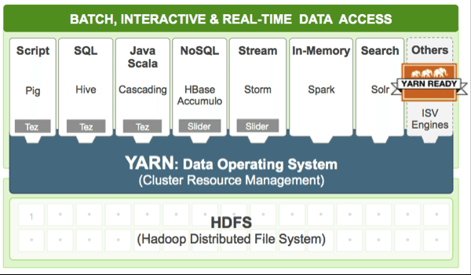
YARN
YARN stands for “Yet Another Resource Negotiator” and is the architectural center of Hadoop 2.0 that allows multiple data processing engines such as interactive SQL, real-time streaming, data science and batch processing to handle data stored in a single platform, unlocking an entirely new approach to analytics.

Slide 70
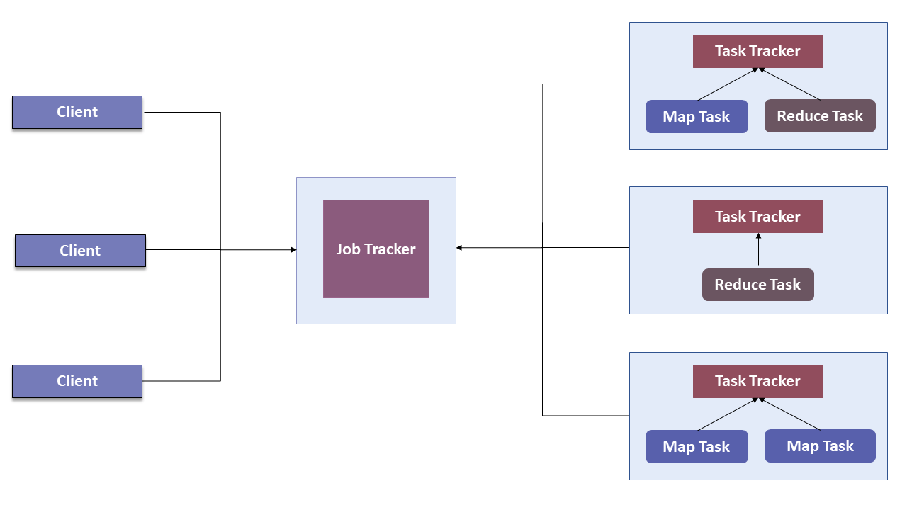
Why YARN?
In Hadoop 1.0 which is also referred to as MRV1(MapReduce Version 1), MapReduce performed both processing and resource management functions. It consisted of a Job Tracker which was the single master. The Job Tracker allocated the resources, performed scheduling and monitored the processing jobs. It assigned map and reduce tasks on a number of subordinate processes called the Task Trackers. The Task Trackers periodically reported their progress to the Job Tracker.

Slide 71
Why YARN cont’d
This design resulted in scalability bottleneck due to a single Job Tracker. IBM mentioned in its article that according to Yahoo!, the practical limits of such a design are reached with a cluster of 5000 nodes and 40,000 tasks running concurrently. Apart from this limitation, the utilization of computational resources is inefficient in MRV1. Also, the Hadoop framework became limited only to MapReduce processing paradigm.
To overcome all these issues, YARN was introduced in Hadoop version 2.0 in the year 2012 by Yahoo and Hortonworks. The basic idea behind YARN is to relieve MapReduce by taking over the responsibility of Resource Management and Job Scheduling. YARN started to give Hadoop the ability to run non-MapReduce jobs within the Hadoop framework.
With the introduction of YARN, the Hadoop ecosystem was completely revolutionalized. It became much more flexible, efficient and scalable. When Yahoo went live with YARN in the first quarter of 2013, it aided the company to shrink the size of its Hadoop cluster from 40,000 nodes to 32,000 nodes.

Slide 72
Introduction to YARN
YARN allows different data processing methods like graph processing, interactive processing, stream processing as well as batch processing to run and process data stored in HDFS. Therefore YARN opens up Hadoop to other types of distributed applications beyond MapReduce. YARN enabled the users to perform operations as per requirement by using a variety of tools like Spark for real-time processing, Hive for SQL, HBase for NoSQL and others. Apart from Resource Management, YARN also performs Job Scheduling. YARN performs all your processing activities by allocating resources and scheduling tasks. Apache Hadoop YARN architecture consists of the following main components :
Resource Manager: Runs on a master daemon and manages the resource allocation in the cluster.
Node Manager: They run on the slave daemons and are responsible for the execution of a task on every single Data Node.
Application Master: Manages the user job lifecycle and resource needs of individual applications. It works along with the Node Manager and monitors the execution of tasks.
Container: Package of resources including RAM, CPU, Network, HDD etc on a single node.

Slide 73
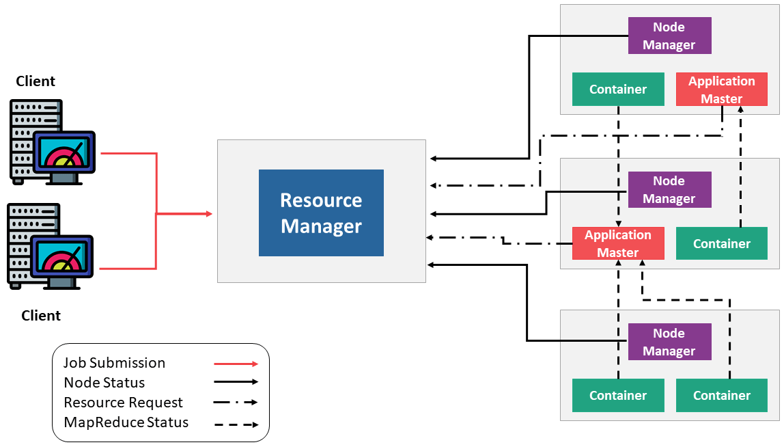
Components of YARN

Slide 74
Resource Manager
It is the ultimate authority in resource allocation.
On receiving the processing requests, it passes parts of requests to corresponding node managers accordingly, where the actual processing takes place.
It is the arbitrator of the cluster resources and decides the allocation of the available resources for competing applications.
Optimizes the cluster utilization like keeping all resources in use all the time against various constraints such as capacity guarantees, fairness, and SLAs.
It has two major components: a) Scheduler b) Application Manager
Scheduler: It is responsible for allocating resources to the various running applications subject to constraints of capacities, queues etc and does not perform any monitoring or tracking of status for the applications. If there is an application failure or hardware failure, the Scheduler does not guarantee to restart the failed tasks.
Application Manager: It is responsible for accepting job submissions. Negotiates the first container from the Resource Manager for executing the application specific Application Master. Manages running the Application Masters in a cluster and provides service for restarting the Application Master container on failure.

Slide 75
Node Manager
It takes care of individual nodes in a Hadoop cluster and manages user jobs and workflow on the given node.
It registers with the Resource Manager and sends heartbeats with the health status of the node.
Its primary goal is to manage application containers assigned to it by the resource manager.
It keeps up-to-date with the Resource Manager.
Application Master requests the assigned container from the Node Manager by sending it a Container Launch Context(CLC) which includes everything the application needs in order to run. The Node Manager creates the requested container process and starts it.
Monitors resource usage (memory, CPU) of individual containers.
Performs Log management.
It also kills the container as directed by the Resource Manager.

Slide 76
Application Master
An application is a single job submitted to the framework. Each such application has a unique Application Master associated with it which is a framework specific entity.
It is the process that coordinates an application’s execution in the cluster and also manages faults.
Its task is to negotiate resources from the Resource Manager and work with the Node Manager to execute and monitor the component tasks.
It is responsible for negotiating appropriate resource containers from the ResourceManager, tracking their status and monitoring progress.
Once started, it periodically sends heartbeats to the Resource Manager to affirm its health and to update the record of its resource demands.

Slide 77
Container
It is a collection of physical resources such as RAM, CPU cores, and disks on a single node.
YARN containers are managed by a container launch context which is container life-cycle(CLC). This record contains a map of environment variables, dependencies stored in a remotely accessible storage, security tokens, payload for Node Manager services and the command necessary to create the process.
It grants rights to an application to use a specific amount of resources (memory, CPU etc.) on a specific host.

Slide 78
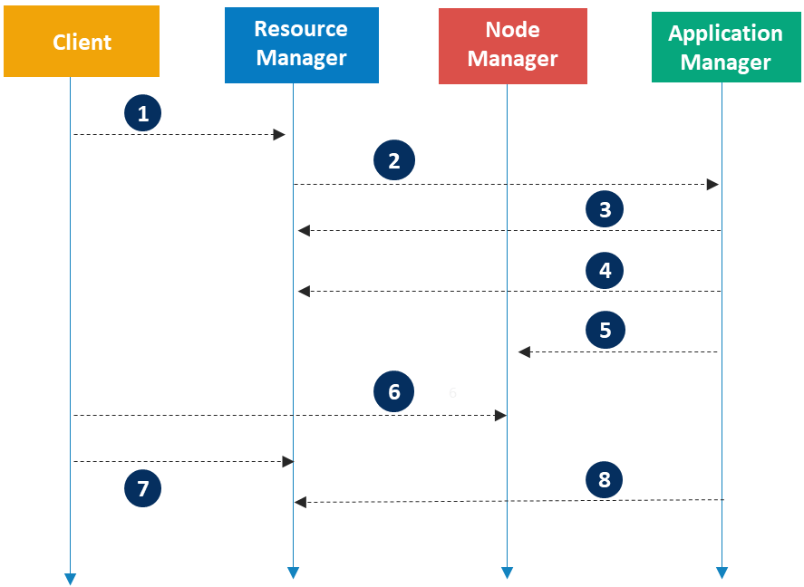
Application Workflow
Client submits an application
Resource Manager allocates a container to start Application Manager
Application Manager registers with Resource Manager
Application Manager asks containers from Resource Manager
Application Manager notifies Node Manager to launch containers
Application code is executed in the container
Client contacts Resource Manager/Application Manager to monitor application’s status
Application Manager unregisters with Resource Manager

Slide 79

Apache Pig

Slide 80
Pig
Apache Pig is an abstraction over MapReduce. It is a tool/platform which is used to analyze larger sets of data representing them as data flows. Pig is generally used with Hadoop and perform all the data manipulation operations.
To write data analysis programs, Pig provides a high-level language known as Pig Latin. This language provides various operators using which programmers can develop their own functions for reading, writing, and processing data.
To analyze data using Apache Pig, programmers need to write scripts using Pig Latin language. All these scripts are internally converted to Map and Reduce tasks. Apache Pig has a component known as Pig Engine that accepts the Pig Latin scripts as input and converts those scripts into MapReduce jobs.

Slide 81
Need of Apache Pig
Programmers who are not so good at Java normally used to struggle working with Hadoop, especially while performing any MapReduce tasks. Apache Pig is a boon for all such programmers.
Using Pig Latin, programmers can perform MapReduce tasks easily without having to type complex codes in Java.
Apache Pig uses multi-query approach, thereby reducing the length of codes. For example, an operation that would require you to type 200 lines of code (LoC) in Java can be easily done by typing as less as just 10 LoC in Apache Pig. Ultimately Apache Pig reduces the development time by almost 16 times.
Pig Latin is SQL-like language and it is easy to learn Apache Pig when you are familiar with SQL.
Apache Pig provides many built-in operators to support data operations like joins, filters, ordering, etc. In addition, it also provides nested data types like tuples, bags, and maps that are missing from MapReduce.

Slide 82
Features of Apache Pig
Apache Pig comes with the following features:
Rich set of operators − It provides many operators to perform operations like join, sort, filer, etc.
Ease of programming − Pig Latin is similar to SQL and it is easy to write a Pig script if you are good at SQL.
Optimization opportunities − The tasks in Apache Pig optimize their execution automatically, so the programmers need to focus only on semantics of the language.
Extensibility − Using the existing operators, users can develop their own functions to read, process, and write data.
UDF’s − Pig provides the facility to create User-defined Functions in other programming languages such as Java and invoke or embed them in Pig Scripts.
Handles all kinds of data − Apache Pig analyzes all kinds of data, both structured as well as unstructured. It stores the results in HDFS.

Slide 83
Apache Pig vs. MapReduce
Apache Pig | MapReduce
Apache Pig is a data flow language | MapReduce is a data processing paradigm.
Performing a Join operation in Apache Pig is pretty simple. | It is quite difficult in MapReduce to perform a Join operation between datasets.
Any novice programmer with a basic knowledge of SQL can work conveniently with Apache Pig. | Exposure to Java is must to work with MapReduce.
Apache Pig uses multi-query approach, thereby reducing the length of the codes to a great extent. | MapReduce require almost 20 times more the number of lines to perform the same task.
There is no need for compilation. On execution, every Apache Pig operator is converted internally into a MapReduce job. | MapReduce jobs have a long compilation process.

Slide 84
Application and History of Apache Pig
Application
Apache Pig is generally used by data scientists for performing tasks involving ad-hoc processing and quick prototyping. Apache Pig is used:
To process huge data sources such as web logs.
To perform data processing for search platforms.
To process time sensitive data loads.
History
In 2006, Apache Pig was developed as a research project at Yahoo, especially to create and execute MapReduce jobs on every dataset. In 2007, Apache Pig was open sourced via Apache incubator. In 2008, the first release of Apache Pig came out. In 2010, Apache Pig graduated as an Apache top-level project.

Slide 85
Apache Pig Architecture
The language used to analyze data in Hadoop using Pig is known as Pig Latin. It is a high level data processing language which provides a rich set of data types and operators to perform various operations on the data.
To perform a particular task Programmers using Pig, programmers need to write a Pig script using the Pig Latin language, and execute them using any of the execution mechanisms (Grunt Shell, UDFs, Embedded). After execution, these scripts will go through a series of transformations applied by the Pig Framework, to produce the desired output.
Internally, Apache Pig converts these scripts into a series of MapReduce jobs, and thus, it makes the programmer’s job easy.

Slide 86
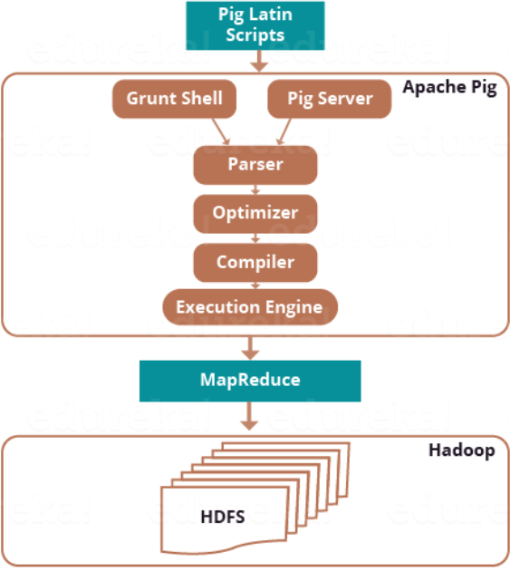
Apache Pig Architecture cont’d

Slide 87
Apache Pig Architecture Components
Parser: Initially the Pig Scripts are handled by the Parser. It checks the syntax of the script, does type checking, and other miscellaneous checks. The output of the parser will be a DAG (directed acyclic graph), which represents the Pig Latin statements and logical operators. In the DAG, the logical operators of the script are represented as the nodes and the data flows are represented as edges.
Optimizer: The logical plan (DAG) is passed to the logical optimizer, which carries out the logical optimizations such as projection and pushdown.
Compiler: The compiler compiles the optimized logical plan into a series of MapReduce jobs.
Execution engine: Finally the MapReduce jobs are submitted to Hadoop in a sorted order. Finally, these MapReduce jobs are executed on Hadoop producing the desired results.

Slide 88
Apache Pig Data Model
Atom: Any single value in Pig Latin, irrespective of their data, type is known as an Atom. It is stored as string and can be used as string and number. int, long, float, double, chararray, and bytearray are the atomic values of Pig. A piece of data or a simple atomic value is known as a field. Ex: ‘Abhi’
Tuple: A record that is formed by an ordered set of fields is known as a tuple, the fields can be of any type. A tuple is similar to a row in a table of RDBMS. Ex: (‘Abhi’, 14)
Bag: A bag is an unordered set of tuples. In other words, a collection of tuples (non-unique) is known as a bag. Each tuple can have any number of fields (flexible schema). A bag is represented by ‘{}’. It is similar to a table in RDBMS, but unlike a table in RDBMS, it is not necessary that every tuple contain the same number of fields or that the fields in the same position (column) have the same type. Ex: {(‘Abhi’), (‘Manu’, (14, 21))}
Map: A map (or data map) is a set of key-value pairs. The key needs to be of type chararray and should be unique. The value might be of any type. It is represented by ‘[]’. Ex: [‘name’#’Raju’, ‘age’#30]
Relation: A relation is a bag of tuples. The relations in Pig Latin are unordered (there is no guarantee that tuples are processed in any particular order).

Slide 89
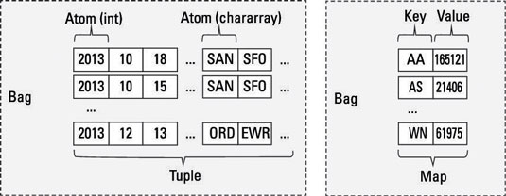
Apache Pig Data Model cont’d
Data Types: Int, Long, Float, Double, charArray, byteArray, tuple, bag, map (collection of tuples)

Slide 90
Apache Pig Latin Execution Modes
Apache Pig can run in two modes, namely, Local Mode and HDFS mode.
Local Mode: In this mode, all the files are installed and run from local host and local file system. There is no need of Hadoop or HDFS. This mode is generally used for testing purpose.
MapReduce Mode: MapReduce mode is where the data loaded or processed that exists in the Hadoop File System (HDFS). In this mode, whenever Pig Latin statements are executed to process the data, a MapReduce job is invoked in the back-end to perform a particular operation on the data that exists in the HDFS.

Slide 91
Apache Pig Latin Execution Mechanisms
Apache Pig scripts can be executed in three ways, namely, interactive mode, batch mode, and embedded mode.
Interactive Mode (Grunt shell) − You can run Apache Pig in interactive mode using the Grunt shell. In this shell, you can enter the Pig Latin statements and get the output (using Dump operator).
Batch Mode (Script) − You can run Apache Pig in Batch mode by writing the Pig Latin script in a single file with .pig extension.
Embedded Mode (UDF) − Apache Pig provides the provision of defining our own functions (User Defined Functions) in programming languages such as Java, and using them in our script.

Slide 92
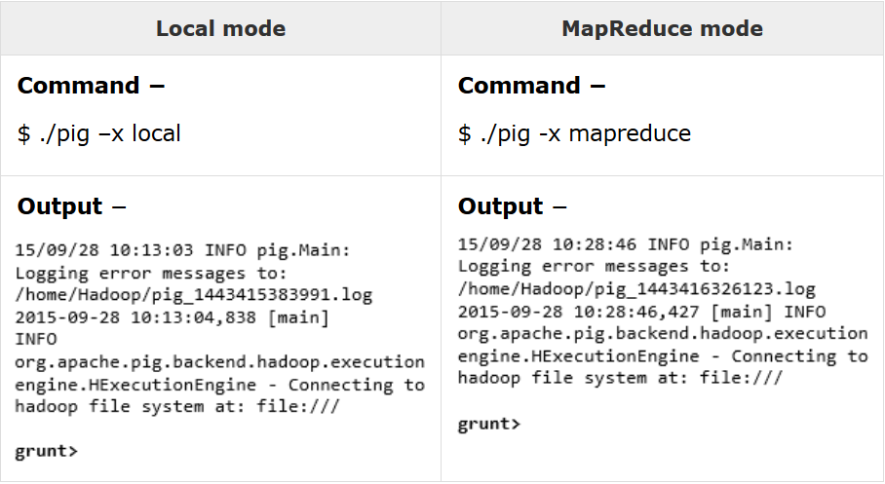
Invoking the Grunt Shell
Grunt shell can be invoked in a desired mode (local/MapReduce) using the −x option as shown below.

Slide 93
Operators
Operator | Description
Loading and Storing
LOAD | To Load the data from the file system (local/HDFS) into a relation.
STORE | To save a relation to the file system (local/HDFS).
Filtering
FILTER | To remove unwanted rows from a relation.
DISTINCT | To remove duplicate rows from a relation.
Diagnostic Operators
DUMP | To print the contents of a relation on the console.
DESCRIBE | To describe the schema of a relation.
Combining and Splitting
UNION | To combine two or more relations into a single relation.
SPLIT | To split a single relation into two or more relations.

Slide 94
Operators cont’d
Operator | Description
Grouping and Joining
JOIN | To join two or more relations.
COGROUP | To group the data in two or more relations.
GROUP | To group the data in a single relation.
Sorting
ORDER | To arrange a relation in a sorted order based on one or more fields (ascending or descending).
LIMIT | To get a limited number of tuples from a relation.

Slide 95
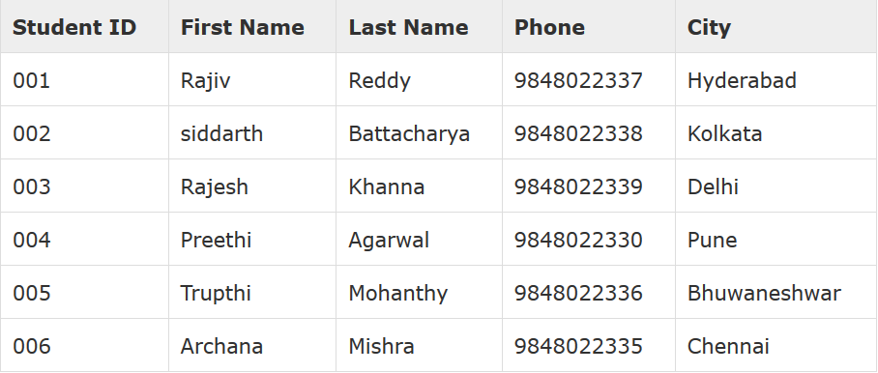
Apache Pig – Reading Data
To analyze data using Apache Pig, the data has to be loaded into Apache Pig. In MapReduce mode, Pig reads (loads) data from HDFS and stores the results back in HDFS. The below dataset contains personal details like id, first name, last name, phone number and city, of six students and stored in student_data.txt with csv format in Hadoop cluster - hdfs://localhost:9000/pig_data/ path.

Slide 96
Apache Pig – Reading Data cont’d
The data to be loaded into Apache Pig from the file system (HDFS/Local) using LOAD operator of Pig Latin.
Syntax: Relation_name = LOAD 'Input file path' USING function as schema where:
relation_name − the relation in which we want to store the data.
Input file path − HDFS directory where the file is stored (MapReduce mode)
function − function from the set of load functions provided by Apache Pig (BinStorage, JsonLoader, PigStorage, TextLoader).
Schema − define the schema of the data. The required schema can be defined as − (column1 : data type, column2 : data type);
Example:
grunt> student = LOAD 'hdfs://localhost:9000/pig_data/student_data.txt'
USING PigStorage(',') as ( id:int, firstname:chararray, lastname:chararray,
phone:chararray, city:chararray );

Slide 97
Apache Pig – Storing Data
The loaded data can be stored in the HDFS file system using the store operator.
Syntax: STORE relation_name INTO ' required_directory_path ' [USING function];
relation_name − the relation in which we want to store the data.
Input file path − HDFS directory where the file is stored (MapReduce mode)
function − function from the set of load functions provided by Apache Pig (BinStorage, JsonLoader, PigStorage, TextLoader).
Example:
grunt> STORE student INTO ' hdfs://localhost:9000/pig_Output/' USING
PigStorage (',');
This would store the relation in the HDFS directory “/pig_Output/” wherein student is the relation as explained in LOAD operator.

Slide 98
Apache Pig – Diagnostic Operators
Dump Operator: It is used to run the Pig Latin statements and display the results on the screen. It is generally used for debugging Purpose.
Syntax: grunt> Dump Relation_Name
Example: grunt> Dump student → Assume data is read into a relation student using the LOAD operator
Describe Operator: It is used to view the schema of a relation.
Syntax: grunt> Describe Relation_Name
Example: grunt> Describe student → Assume data is read into a relation student using the LOAD operator
Explain Operator: It is used to display the logical, physical, and MapReduce execution plans of a relation
Syntax: grunt> explain Relation_Name
Example: grunt> explain student → Assume data is read into a relation student using the LOAD operator

Slide 99
Apache Pig – Group Operators
Group Operator: It is used to group the data in one or more relations. It collects the data having the same key.
Example: grunt> group_data = GROUP student by age; → Assume data is read into a relation student using the LOAD operator
Example: grunt> group_data = GROUP student by (age, city); → Assume data is read into a relation student using the LOAD operator and it’s the illustration of multiple columns grouping
Group ALL Operator: A relation can be grouped by all the columns and is shown below.
Example: grunt> group_all = GROUP student_details All;
Cogroup Operator: The only difference between the Group and Cogroup operators is that the group operator is normally used with one relation, while the cogroup operator is used in statements involving two or more relations.

Slide 100
Apache Pig – Cogroup Operator Example
grunt> student_details = LOAD 'hdfs://localhost:9000/pig_data/student_details.txt' USING PigStorage(',')
as (id:int, firstname:chararray, lastname:chararray, age:int, phone:chararray, city:chararray);
grunt> employee_details = LOAD 'hdfs://localhost:9000/pig_data/employee_details.txt' USING PigStorage(',')
as (id:int, name:chararray, age:int, city:chararray);
Now, let us group the records/tuples of the relations student_details and employee_details with the key age, as shown below.
grunt> cogroup_data = COGROUP student_details by age, employee_details by age;
The cogroup operator groups the tuples from each relation according to age where each group depicts a particular age value.

Slide 101
Apache Pig – Join Operator
The JOIN operator is used to combine records from two or more relations. While performing a join operation, we declare one (or a group of) tuple(s) from each relation, as keys. When these keys match, the two particular tuples are matched, else the records are dropped. Joins can be of the following types −
Self-join: It is used to join a table with itself as if the table were two relations, temporarily renaming at least one relation.
Inner-join: returns rows when there is a match in both tables.
Outer-join:
Left outer join: returns all rows from the left table, even if there are no matches in the right relation.
Right outer join: returns all rows from the right table, even if there are no matches in the left table.
Full outer join: returns rows when there is a match in one of the relations.

Slide 102
Apache Pig – Self-Join Operator Example
Self-join: Generally, in Apache Pig, to perform self-join, we will load the same data multiple times, under different aliases (names). Therefore let us load the contents of the file customers.txt as two tables as shown below.
grunt> customers1 = LOAD 'hdfs://localhost:9000/pig_data/customers.txt' USING PigStorage(',') as (id:int, name:chararray, age:int, address:chararray, salary:int);
grunt> customers2 = LOAD 'hdfs://localhost:9000/pig_data/customers.txt' USING PigStorage(',') as (id:int, name:chararray, age:int, address:chararray, salary:int);
Example: Let us perform self-join operation on the relation customers, by joining the two relations customers1 and customers2 as shown below.
grunt> customers3 = JOIN customers1 BY id, customers2 BY id;

Slide 103
Apache Pig – Inner Join Operator Example
Inner-join: It creates a new relation by combining column values of two relations (say A and B) based upon the join-predicate. The query compares each row of A with each row of B to find all pairs of rows which satisfy the join-predicate. When the join-predicate is satisfied, the column values for each matched pair of rows of A and B are combined into a result row.
grunt> customers = LOAD 'hdfs://localhost:9000/pig_data/customers.txt' USING PigStorage(',') as (id:int, name:chararray, age:int, address:chararray, salary:int);
grunt> orders = LOAD 'hdfs://localhost:9000/pig_data/orders.txt' USING PigStorage(',') as (oid:int, date:chararray, customer_id:int, amount:int);
Example: Let us perform inner join operation on the two relations customers and orders as shown below.
grunt> coustomer_orders = JOIN customers BY id, orders BY customer_id;

Slide 104
Apache Pig – Outer Join Operator Example
grunt> customers = LOAD 'hdfs://localhost:9000/pig_data/customers.txt' USING PigStorage(',') as (id:int, name:chararray, age:int, address:chararray, salary:int);
grunt> orders = LOAD 'hdfs://localhost:9000/pig_data/orders.txt' USING PigStorage(',') as (oid:int, date:chararray, customer_id:int, amount:int);
Example :
grunt> outer_left = JOIN customers BY id LEFT OUTER, orders BY customer_id;
grunt> outer_right = JOIN customers BY id RIGHT OUTER, orders BY customer_id;
grunt> outer_full = JOIN customers BY id FULL OUTER, orders BY customer_id;

Slide 105
Apache Pig – Cross Operator
The CROSS operator computes the cross-product of two or more relations.
Example:
grunt> customers = LOAD 'hdfs://localhost:9000/pig_data/customers.txt' USING PigStorage(',') as (id:int, name:chararray, age:int, address:chararray, salary:int);
grunt> orders = LOAD 'hdfs://localhost:9000/pig_data/orders.txt' USING PigStorage(',') as (oid:int, date:chararray, customer_id:int, amount:int);
grunt> cross_data = CROSS customers, orders;
grunt> Dump cross_data;

Slide 106
Apache Pig – Union Operator
The UNION operator of Pig Latin is used to merge the content of two relations. To perform UNION operation on two relations, their columns and domains must be identical.
Example:
grunt> student1 = LOAD 'hdfs://localhost:9000/pig_data/student_data1.txt' USING PigStorage(',') as (id:int, firstname:chararray, lastname:chararray, phone:chararray, city:chararray);
grunt> student2 = LOAD 'hdfs://localhost:9000/pig_data/student_data2.txt' USING PigStorage(',') as (id:int, firstname:chararray, lastname:chararray, phone:chararray, city:chararray);
grunt> student = UNION student1, student2;
grunt> Dump student;

Slide 107
Apache Pig – Split Operator
The SPLIT operator is used to split a relation into two or more relations.
Example:
grunt> student = LOAD 'hdfs://localhost:9000/pig_data/student.txt' USING PigStorage(',') as (id:int, firstname:chararray, lastname:chararray, age:int, phone:chararray, city:chararray);
Let us now split the relation into two, one listing the students of age less than 23, and the other listing the students having the age between 22 and 25.
grunt> SPLIT student into student1 if age<23, student2 if (22<age and age>25);
grunt> Dump student1;
grunt> Dump student2;

Slide 108
Apache Pig – Distinct Operator
The DISTINCT operator is used to remove redundant (duplicate) tuples from a relation.
Syntax:
grunt> student = LOAD 'hdfs://localhost:9000/pig_data/student.txt' USING PigStorage(',') as (id:int, firstname:chararray, lastname:chararray, age:int, phone:chararray, city:chararray);
Assume there are some duplicate tuples in the relation
grunt> distinct_data = DISTINCT student;
grunt> Dump distinct_data ;

Slide 109
Apache Pig – Foreach Operator
The FOREACH operator is used to generate specified data transformations based on the column data.
Example:
grunt> student_details = LOAD 'hdfs://localhost:9000/pig_data/student.txt' USING PigStorage(',') as (id:int, firstname:chararray, lastname:chararray, age:int, phone:chararray, city:chararray);
Assume there are 8 tuples in the relation and get the id, age, and city values of each student from the relation student_details and store it into another relation named foreach_data
grunt> foreach_data = FOREACH student_details GENERATE id,age,city;
grunt> Dump foreach_data ;

Slide 110
Apache Pig – Order By Operator
The ORDER BY operator is used to display the contents of a relation in a sorted order based on one or more fields.
Example:
grunt> student_details = LOAD 'hdfs://localhost:9000/pig_data/student.txt' USING PigStorage(',') as (id:int, firstname:chararray, lastname:chararray, age:int, phone:chararray, city:chararray);
Sort the relation in a descending order based on the age of the student and store it into another relation named order_by_data
grunt> order_by_data = ORDER student_details BY age DESC;
grunt> Dump order_by_data ;

Slide 111
Apache Pig – LIMIT Operator
The LIMIT operator is used to get a limited number of tuples from a relation.
Example:
grunt> student_details = LOAD 'hdfs://localhost:9000/pig_data/student.txt' USING PigStorage(',') as (id:int, firstname:chararray, lastname:chararray, age:int, phone:chararray, city:chararray);
Sort the relation in a descending order based on the age of the student and store it into another relation named order_by_data and then limit the data to 4 and then store it into another relation named limit_data
grunt> order_by_data = ORDER student_details BY age DESC;
grunt> limit_data = LIMIT order_by_data 4;
grunt> Dump limit_data ;

Slide 112

Apache Hive

Slide 113
Hive
Apache Hive is a data warehouse system built on top of Hadoop and is used for analyzing structured and semi-structured data. Hive abstracts the complexity of Hadoop MapReduce. Basically, it provides a mechanism to project structure onto the data and perform queries written in HQL (Hive Query Language) that are similar to SQL statements. Internally, these queries or HQL gets converted to map reduce jobs by the Hive compiler. Therefore, one don’t need to worry about writing complex MapReduce programs to process data using Hadoop. It is targeted towards users who are comfortable with SQL. Apache Hive supports Data Definition Language (DDL), Data Manipulation Language (DML) and Pluggable Functions.
DDL: create table, create index, create views.
DML: Select, Where, group by, Join, Order By
Pluggable Functions:
UDF: User Defined Function
UDAF: User Defined Aggregate Function
UDTF: User Defined Table Function

Slide 114
Hive Data Types
Numeric Types
TINYINT (1-byte signed integer, from -128 to 127)
SMALLINT (2-byte signed integer, from -32,768 to 32,767)
INT (4-byte signed integer, from -2,147,483,648 to 2,147,483,647)
BIGINT (8-byte signed integer, from -9,223,372,036,854,775,808 to 9,223,372,036,854,775,807)
FLOAT (4-byte single precision floating point number)
DOUBLE (8-byte double precision floating point number)
DECIMAL (Hive 0.13.0 introduced user definable precision and scale)
Date/Time Types
TIMESTAMP
DATE
String Types
STRING
VARCHAR
Misc Types
BOOLEAN
BINARY
CHAR

Slide 115
Self Study – Built-in Operators
Relational Operators
Arithmetic
Operators
Logical
Operators
Complex
Operators

Slide 116
Hive DDL Commands
Create Database Statement: A database in Hive is a namespace or a collection of tables. The syntax for this statement is: CREATE DATABASE|SCHEMA [IF NOT EXISTS] <database name>. IF NOT EXISTS is an optional clause, which notifies the user that a database with the same name already exists. We can use SCHEMA in place of DATABASE in this command.
hive> CREATE SCHEMA userdb; → Create the database by name userdb
hive> SHOW DATABASES; → verify a databases list
Drop Database Statement: Drop Database is a statement that drops all the tables and deletes the database. Its syntax is: DROP DATABASE StatementDROP (DATABASE|SCHEMA) [IF EXISTS] database_name [RESTRICT|CASCADE];
hive> DROP DATABASE IF EXISTS userdb; → drop a database by name userdb
hive> DROP DATABASE IF EXISTS userdb; → drops the database using CASCADE i.e. dropping respective tables before dropping the database.

Slide 117
Hive DDL Commands cont’d
Create Table Statement: Create Table is a statement used to create a table in Hive. Syntax:
CREATE [TEMPORARY] [EXTERNAL] TABLE [IF NOT EXISTS] [db_name.] table_name
[(col_name data_type [COMMENT col_comment], ...)]
[COMMENT table_comment]
[ROW FORMAT row_format]
[STORED AS file_format]
Example: Let us assume to create a table named employee. The following table lists the fields and their data types in employee table:
Sr. No | Field Name | Data Type
1 | EID | int
2 | Name | String
3 | Salary | Float

Slide 118
Create Table Statement
The following data is a Comment, Row formatted fields such as Field terminator, Lines terminator, and Stored File type.
COMMENT ‘Employee details’
FIELDS TERMINATED BY ‘\t’
LINES TERMINATED BY ‘\n’
STORED IN TEXT FILE
The following query creates a table named employee using the above data.
hive> CREATE TABLE IF NOT EXISTS employee ( eid int, name String,
salary String)
COMMENT ‘Employee details’
ROW FORMAT DELIMITED
FIELDS TERMINATED BY ‘\t’
LINES TERMINATED BY ‘\n’
STORED AS TEXTFILE;

Slide 119
Load Data Statement
Generally, after creating a table in SQL, we can insert data using the Insert statement. But in Hive, we can insert data using the LOAD DATA statement. While inserting data into Hive, it is better to use LOAD DATA to store bulk records. There are two ways to load data: one is from local file system and second is from Hadoop file system.
Syntax: The syntax for load data is as follows:
LOAD DATA [LOCAL] INPATH 'filepath' [OVERWRITE] INTO TABLE tablename
[PARTITION (partcol1=val1, partcol2=val2 ...)]
LOCAL is identifier to specify the local path. It is optional.
OVERWRITE is optional to overwrite the data in the table.
PARTITION is optional.

Slide 120
Load Data Statement Example
Let's insert the following data into the table. It is a text file named sample.txt in /home/user directory.
1201 Gopal 45000 Technical manager
1202 Manisha 45000 Proof reader
1203 Masthanvali 40000 Technical writer
1204 Kiran 40000 Hr Admin
1205 Kranthi 30000 Op Admin
The following query loads the given text into the table.
hive> LOAD DATA LOCAL INPATH '/home/user/sample.txt'
OVERWRITE INTO TABLE employee;

Slide 121
Alter Table
It is used to alter a table in Hive.
Syntax: The statement takes any of the following syntaxes based on what attributes we wish to modify in a table.
ALTER TABLE name RENAME TO new_name
ALTER TABLE name ADD COLUMNS (col_spec[, col_spec ...])
ALTER TABLE name DROP [COLUMN] column_name
ALTER TABLE name CHANGE column_name new_name new_type
ALTER TABLE name REPLACE COLUMNS (col_spec[, col_spec ...])
Example:
hive> ALTER TABLE employee RENAME TO emp; → Rename the table from employee to emp
ALTER TABLE employee CHANGE name ename String; → Rename the column from name to ename
hive> ALTER TABLE employee ADD COLUMNS (dept STRING COMMENT 'Department name'); → add a column named dept to the employee table

Slide 122
Hive Partitioning
Hive organizes tables into partitions. It is a way of dividing a table into related parts based on the values of partitioned columns such as date, city, and department. Using partition, it is easy to query a portion of the data.
Tables or partitions are sub-divided into buckets, to provide extra structure to the data that may be used for more efficient querying. Bucketing works based on the value of hash function of some column of a table.
For example, a table named Tab1 contains employee data such as id, name, dept, and yoj (i.e., year of joining). Suppose you need to retrieve the details of all employees who joined in 2012. A query searches the whole table for the required information. However, if you partition the employee data with the year and store it in a separate file, it reduces the query processing time.

Slide 123
Hive Partitioning Example
The following file contains employeedata table.
/tab1/employeedata/file1
id, name, dept, yoj
1, gopal, TP, 2012
2, kiran, HR, 2012
3, kaleel,SC, 2013
4, Prasanth, SC, 2013
The above data is partitioned into two files using year.
/tab1/employeedata/2012/file2 /tab1/employeedata/2013/file3
1, gopal, TP, 2012 3, kaleel,SC, 2013
2, kiran, HR, 2012 4, Prasanth, SC, 2013

Slide 124
Hive QL
The Hive Query Language (HiveQL) is a query language for Hive to process and analyze structured data in a Metastore.
Select-Where Statement
SELECT statement is used to retrieve the data from a table. WHERE clause works similar to a condition. It filters the data using the condition and gives you a finite result. The built-in operators and functions generate an expression, which fulfils the condition.
Syntax:
SELECT [ALL | DISTINCT] select_expr, select_expr, ...
FROM table_reference
[WHERE where_condition]
[GROUP BY col_list]
[HAVING having_condition]
[CLUSTER BY col_list | [DISTRIBUTE BY col_list] [SORT BY col_list]]
[LIMIT number];

Slide 125
Select-Where Example
Let us take an example for SELECT…WHERE clause. Assume we have the employee table, with fields named Id, Name, Salary, Designation, and Dept.
Generate a query to retrieve the employee details who earn a salary of more than Rs 30000.
hive> SELECT * FROM employee WHERE salary>30000;
Generate a query to retrieve the employee details who belongs to IT dept.
hive> SELECT * FROM employee WHERE dept=‘IT’;
Generate a query to retrieve the employee details who belongs to IT dept and drawing more than Rs 30000..
hive> SELECT * FROM employee WHERE dept=‘IT’ AND salary>30000;

Slide 126
Self Study – Hive QL
Select-Order By
Select-Group By
Select-Joins

Slide 127
Self Study
Views
Indexes
Built-in Functions

Slide 128

Apache Scoop

Slide 129
Scoop
Sqoop is a tool designed to transfer data between Hadoop and relational database servers. It is used to import data from relational databases such as MySQL, Oracle to Hadoop HDFS, and export from Hadoop file system to relational databases.
The traditional application management system, that is, the interaction of applications with relational database using RDBMS, is one of the sources that generate Big Data. Such Big Data, generated by RDBMS, is stored in Relational Database Servers in the relational database structure.
When Big Data storages and analyzers such as MapReduce, Hive, Pig, etc. of the Hadoop ecosystem came into picture, they required a tool to interact with the relational database servers for importing and exporting the Big Data residing in them. Here, Sqoop occupies a place in the Hadoop ecosystem to provide feasible interaction between relational database server and Hadoop’s HDFS.
Sqoop − “SQL to Hadoop and Hadoop to SQL”

Slide 130
How Sqoop Works?
RDBMS (MySQL, Oracle, DB2, SQL Server)
Sqoop Tool
Hadoop File System (HDFS, Hive, HBase)
Import
Export
Sqoop Import: The import tool imports individual tables from RDBMS to HDFS. Each row in a table is treated as a record in HDFS. All records are stored as text data in text files or as binary data in Avro and Sequence files.
Sqoop Export: The export tool exports a set of files from HDFS back to an RDBMS. The files given as input to Sqoop contain records, which are called as rows in table. Those are read and parsed into a set of records and delimited with user-specified delimiter.

Slide 131
Sqoop - Import
The ‘Import tool’ imports individual tables from RDBMS to HDFS. Each row in a table is treated as a record in HDFS. All records are stored as text data in the text files or as binary data in Avro and Sequence files.
Syntax: $ sqoop import (generic-args) (import-args)
$ sqoop-import (generic args) (import args) → alternative approach
The Hadoop specific generic arguments must precede any import arguments, and the import arguments can be of any order.
Importing a Table into HDFS
$ sqoop import --connect --table --username --password --target-dir
--connect Takes JDBC url and connects to database
--table Source table name to be imported
--username Username to connect to database
--password Password of the connecting user
--target-dir Imports data to the specified directory

Slide 132
Sqoop – Import cont’d
Importing Selected Data from Table
$ sqoop import --connect --table --username --password --columns --where
--columns Selects subset of columns
--where Retrieves the data which satisfies the condition
Importing Data from Query
$ sqoop import --connect --table --username --password --query
--query Executes the SQL query provided and imports the results
Importing Data from Query
$ sqoop import --connect --table --username --password --incremental <mode> --check-column <column name> --last-value <last check column value>
Sqoop import supports two types of incremental imports mode namely Append, and Lastmodified.

Slide 133
Sqoop – Import Example
Let us take an example of three tables named as emp (ID, Name, Des, Dalary, Dept), emp_address (ID, House_No, Street, City, Pincode), and emp_contact (ID, Phone_No, Email), which are in a database called userdb in a MySQL database server.
Importing a Table into HDFS:
$ sqoop import -- connect jdbc:mysql://localhost/userdb \
--username root --table emp
Importing a Table into Target Directory:
$ sqoop import -- connect jdbc:mysql://localhost/userdb \
--username root --table emp_address --target-dir /emp_addr
Import Subset of Table Data:
$ sqoop import -- connect jdbc:mysql://localhost/userdb \
--username root --table emp_contact --where “Phone_No =’953467890’”

Slide 134
Sqoop – Import Example cont’d
Incremental Import :
$ sqoop import --connect jdbc:mysql://localhost/userdb --username root \
--table emp --incremental append --check-column ID --last value 1205
Import All Tables
Syntax:
$ sqoop import-all-tables (generic-args) (import-args)
$ sqoop-import-all-tables (generic-args) (import-args) → alternative approach
Note: If import-all-tables is used, it is mandatory that every table in that database must have a primary key field.
Example:
$ sqoop import-all-tables --connect jdbc:mysql://localhost/userdb \
--username root

Slide 135
Sqoop - Export
The ‘Export tool’ export data back from the HDFS to the RDBMS database. The target table must exist in the target database. The files which are given as input to the Sqoop contain records, which are called rows in table. Those are read and parsed into a set of records and delimited with user-specified delimiter.
The default operation is to insert all the record from the input files to the database table using the INSERT statement. In update mode, Sqoop generates the UPDATE statement that replaces the existing record into the database.
Syntax: $ sqoop export (generic-args) (import-args)
$ sqoop-export (generic args) (import args) → alternative approach
Example:
Let us take an example of the employee data in file, in HDFS. The employee data is available in emp_data file in ‘emp/’ directory in HDFS.
It is mandatory that the table to be exported is created manually and is present in the database from where it has to be exported.

Slide 136
Sqoop – Export Example
The following query is to create the table ‘employee’ in mysql command line.
$ mysql
mysql> USE db;
mysql> CREATE TABLE employee (id INT NOT NULL PRIMARY KEY,
name VARCHAR(20), deg VARCHAR(20), salary INT, dept VARCHAR(10));
The following command is used to export the table data (which is in emp_data file on HDFS) to the employee table in db database of Mysql database server.
$ sqoop export --connect jdbc:mysql://localhost/db --username root \
--table employee --export-dir /emp/emp_data
The following command is used to verify the table in mysql command line.
mysql>select * from employee;

Slide 137

Apache HBase

Slide 138
HBase
HBase is a data model designed to provide quick random access to huge amounts of structured data. It is a distributed column-oriented database built on top of the Hadoop file system. It is an open-source project and is horizontally scalable. It leverages the fault tolerance provided by the HDFS. It is a part of the Hadoop ecosystem that provides random real-time read/write access to data
Limitations of Hadoop
Hadoop accessed data only in a sequential manner. That means one has to search the entire dataset even for the simplest of jobs. A huge dataset when processed results in another huge data set, which should also be processed sequentially. At this point, a new solution is needed to access any point of data in a single unit of time (random access).
Hadoop Random Access Databases
Storage applications such as HBase, Cassandra, couchDB, Dynamo, and MongoDB are some of the databases that store huge amounts of data and access the data in a random manner.

Slide 139
HBase cont’d
One can store the data in HDFS either directly or through HBase. Data consumer reads/accesses the data in HDFS randomly using HBase. HBase sits on top of the Hadoop File System and provides read and write access.
Read
HBase
Write
R
e
a
d
W
r
i
t
e
Data
Producer
Data
Consumer
HDFS
Write

Slide 140
HDFS vs. HBase
HDFS | HBase
HDFS is a distributed file system suitable for storing large files. | HBase is a database built on top of the HDFS.
HDFS does not support fast individual record lookups. | HBase provides fast lookups for larger tables.
It provides high latency batch processing. | It provides low latency access to single rows from billions of records (Random access).
It provides only sequential access of data. | HBase internally uses Hash tables and provides random access, and it stores the data in indexed HDFS files for faster lookups.

Slide 141
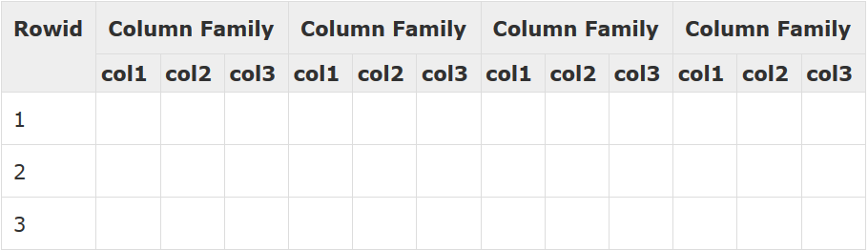
Storage Mechanism in HBase
HBase is a column-oriented database and the tables in it are sorted by row. The table schema defines only column families, which are the key value pairs. A table have multiple column families and each column family can have any number of columns. Subsequent column values are stored contiguously on the disk. Each cell value of the table has a timestamp. In short, in an HBase:
Table is a collection of rows.
Row is a collection of column families.
Column family is a collection of columns.
Column is a collection of key value pairs.
Example:

Slide 142
HBase Architecture
Client
ZooKeeper
HMaster
HRegionServer
HRegionServer
HRegionServer
HRegion
HRegion
HRegion
HRegion
HRegion
HRegion
HDFS

Slide 143
HBase Architecture cont’d
HBase architecture consists mainly of four components
HMaster
HRegionserver
HRegions
Zookeeper
HDFS
HMaster: HMaster is the implementation of a Master server in HBase architecture. It acts as a monitoring agent to monitor all Region Server instances present in the cluster and acts as an interface for all the metadata changes. In a distributed cluster environment, Master runs on NameNode. Master runs several background threads.
The client communicates in a bi-directional way with both HMaster and ZooKeeper. For read and write operations, it directly contacts with HRegion servers. HMaster assigns regions to region servers and in turn, check the health status of region servers.

Slide 144
HBase Architecture cont’d
HRegions Servers: When Region Server receives writes and read requests from the client, it assigns the request to a specific region, where the actual column family resides. However, the client can directly contact with HRegion servers, there is no need of HMaster mandatory permission to the client regarding communication with HRegion servers. The client requires HMaster help when operations related to metadata and schema changes are required.
HRegionServer is the Region Server implementation. It is responsible for serving and managing regions or data that is present in a distributed cluster. The region servers run on Data Nodes present in the Hadoop cluster.
HRegions: HRegions are the basic building elements of HBase cluster that consists of the distribution of tables and are comprised of Column families. It contains multiple stores, one for each column family. It consists of mainly two components, which are Memstore and Hfile.

Slide 145
HBase Architecture cont’d
ZooKeeper: In HBase, Zookeeper is a centralized monitoring server which maintains configuration information and provides distributed synchronization. Distributed synchronization is to access the distributed applications running across the cluster with the responsibility of providing coordination services between nodes. If the client wants to communicate with regions, the server's client has to approach ZooKeeper first.
Conclusion: HBase is one of NoSql column-oriented distributed database available in Apache foundation. HBase gives more performance for retrieving fewer records rather than Hadoop or Hive. It's very easy to search for given any input value because it supports indexing, transactions, and updating. Online real-time analytics can be performed using HBase integrated with Hadoop ecosystem. It has an automatic and configurable sharding for datasets or tables and provides restful API's to perform the MapReduce jobs.

Slide 146


